Slide 1
MULTILEVEL INVERTER BASED ON SWITCHED-CAPACITANCE STRUCTURE
Guided By,
Prof. Sanish Kumar T G
Department of EEE
GEC Thrissur
Presented By,
Abhilash M M(2) S8 EEE A
Alin Anto(16) S8 EEE A
Devika Sajeev(40) S8 EEE A
Don Dev(44) S8 EEE A

Slide 2
Contents
Methodology
Modes Of Operation
Simulation
Simulation-Output
Simulation-Results
References

Slide 3
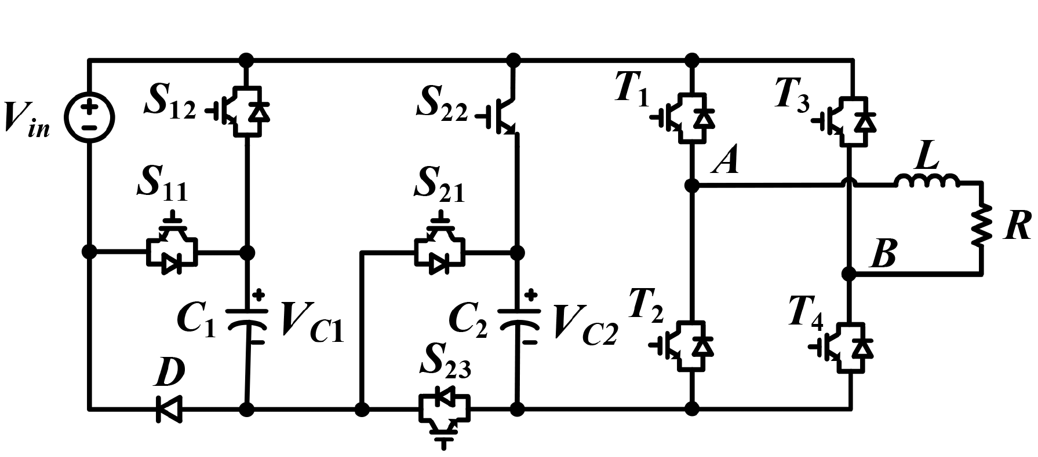
Methodology
Switched-capacitor (SC) structure is added to the H-bridge inverter.
The SC structures creates a multilevel DC voltage at the DC bus of the H-bridge circuit.
H-bridge circuit inverts the multilevel DC voltage to AC voltage.

Slide 4
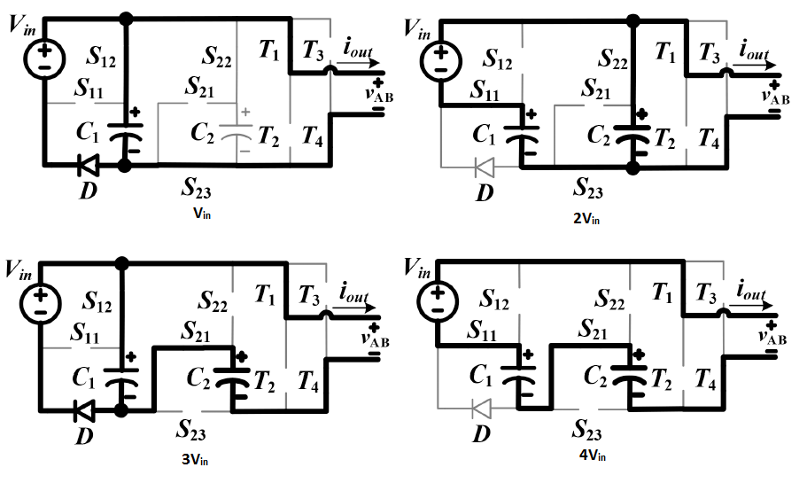
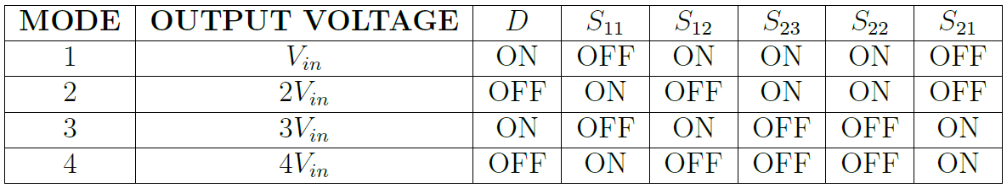
Modes of operation

Slide 5
Modes of operation
1V_{in} – Source and C₁ in parallel.
2V_{in} – Source and C₁ in series which is then parallel with C_{2.}
3V_{in} – Source and C₁ in parallel which is then series with C_{2.}
4V_{in} – Source, C₁ and C₂ all in series.

Slide 6
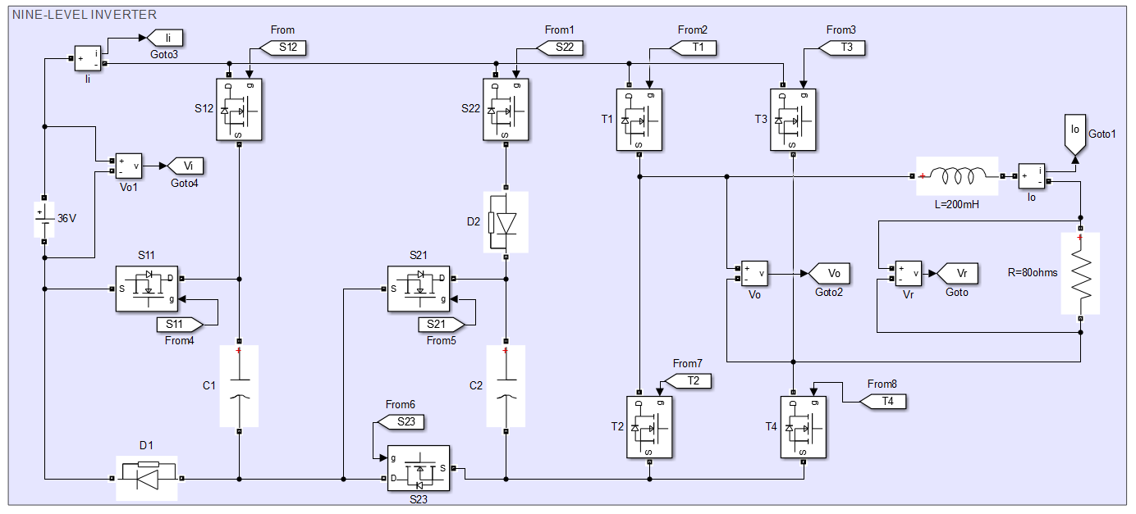
Simulation

Slide 7
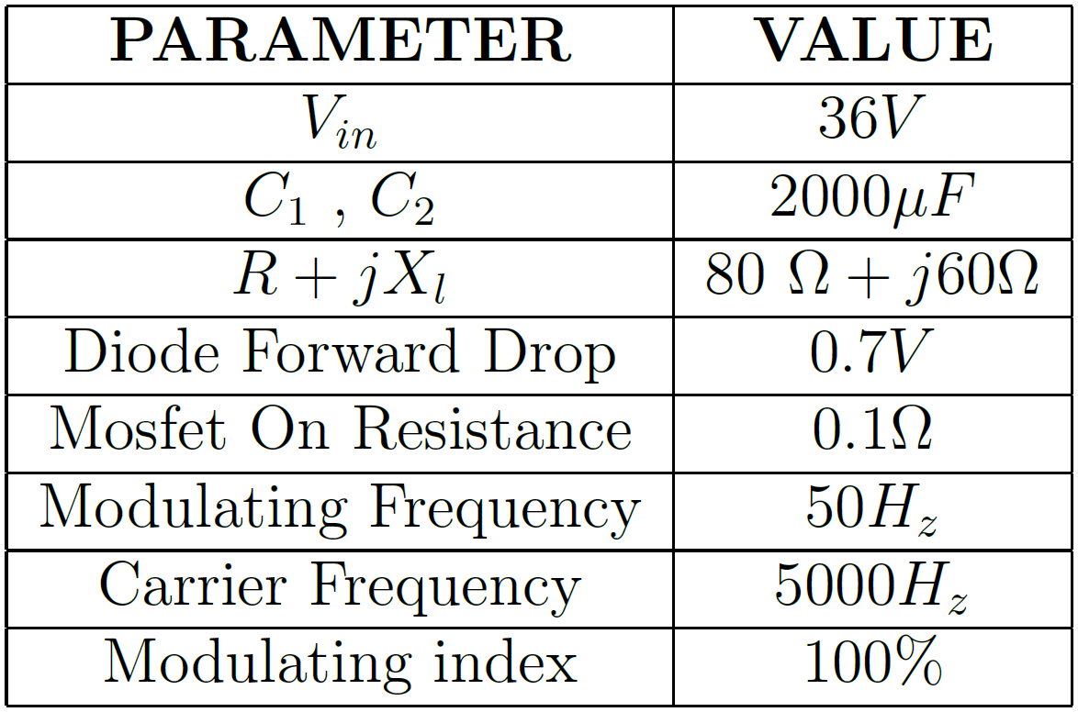
Simulation

Slide 8
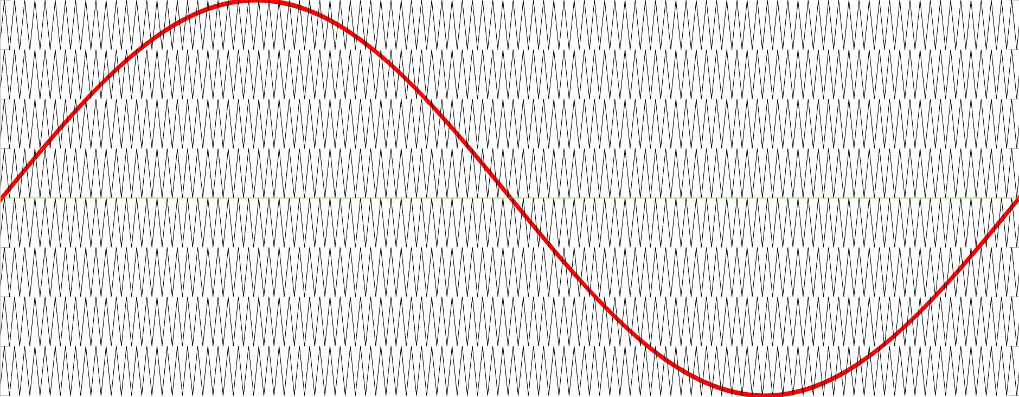
Phase Disposition PWM

Slide 9
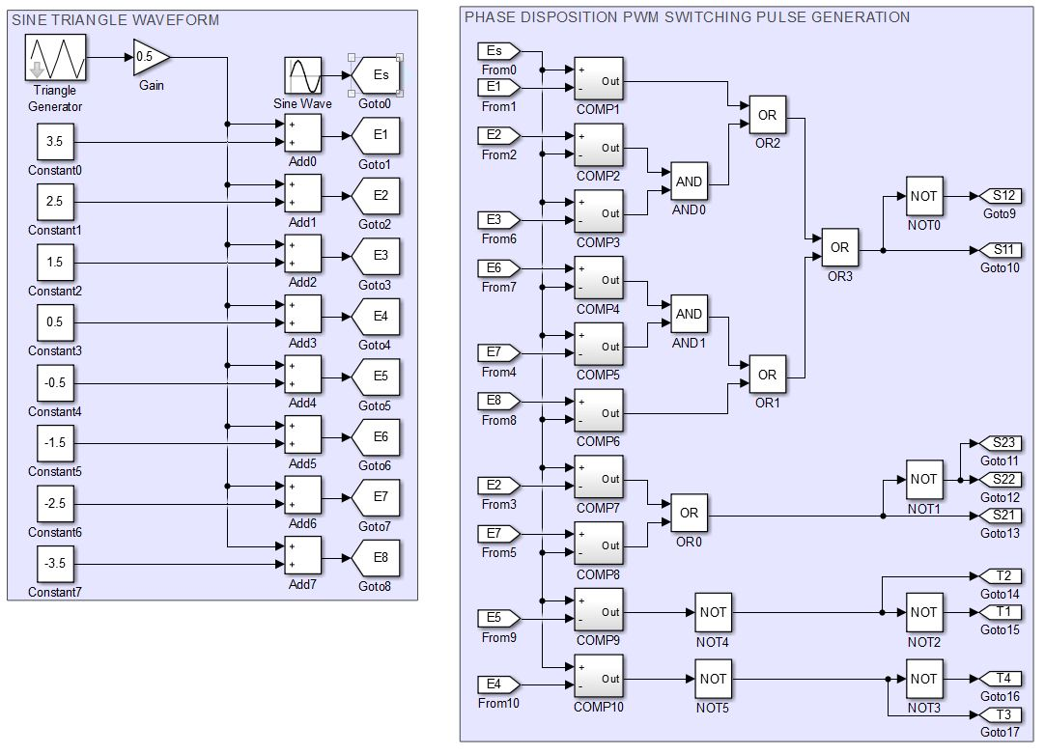
Phase Disposition PWM

Slide 10
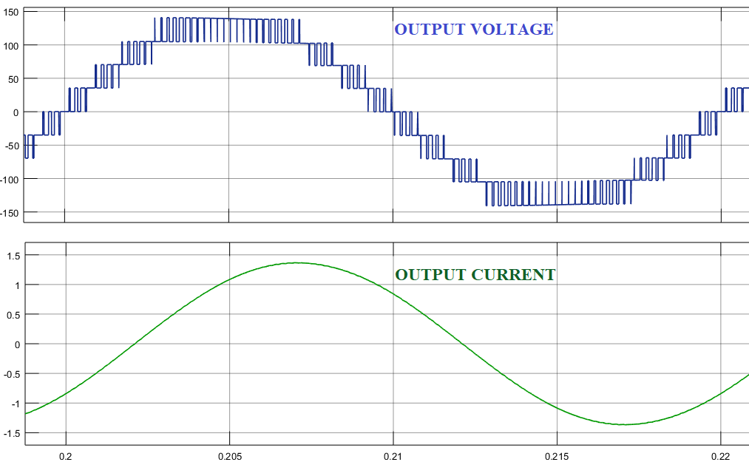
Simulation-Output

Slide 11
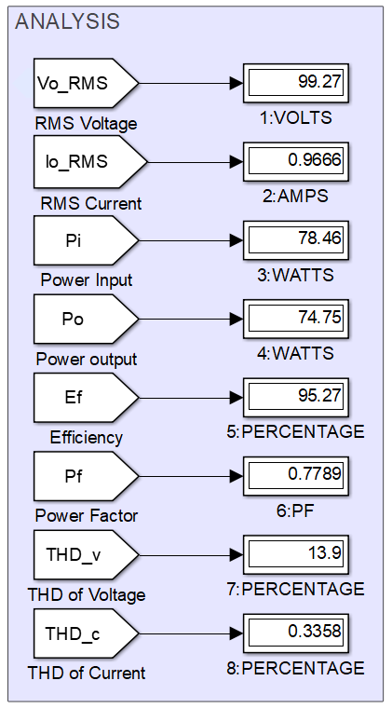
Simulation-Result
The THD in current is only 0.3358%.
The efficiency of the inverter is 95.27%

Slide 12
REFERENCE
[1] Bac-Bien Ngo, Minh-Khai Nguyen , Jae-Hong Kim2 and Firuz Zare, “Single-phase multilevel inverter based on switched-capacitor structure”, IET Power Electron, June 2018, ISSN 1755-4535
[2] Barry W Williams, “Principles and Elements of Power Electronics Devices, Drivers, Applications, and Passive Components”, 2006, ISBN 978-0-9553384-0-3
[3] Yuanmao Ye, K. W. E. Cheng, Junfeng Liu and Kai Ding, “A Step-Up Switched-Capacitor Multilevel Inverter With Self-Voltage Balancing”, IEEE Trans. Ind. Electron, Vol. 61, No. 12, December 2014
[4] Bhagyalakshmi P S, Beena M Varghese and Dr. Bos Mathew Jos, “Switched Capacitor Multilevel Inverter With Different Modulation Techniques”, International Conference on Innovations in information Embedded and Communication Systems, 2017

Slide 13
Thank you

